Slide 1
Telescope Parallel Actuator Mount: Control and Testing
Sam Artho-Bentz
Notes:
Focus primarily on Mechatronics
Follow up to Garrett Gudgel’s thesis

Slide 2
Motivation
Design stuff
Math stuff
Testing Stuff
Procedure & Results
Possible improvements

Slide 3
Goals
Further investigate the viability of the Parallel Actuator Mount for astronomical use
Minimize custom built components, especially in the control system
Develop velocity control
Develop software that can be customized and expanded by others implementing this style of mount.
Establish testing protocol to allow future iterations of the PAM to be compared.

Slide 4
Background

Slide 5
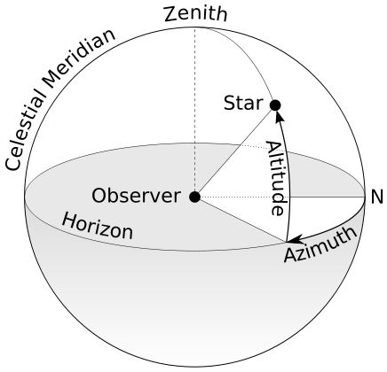
Pointing a Telescope
Multiple ways to define where a telescope is pointing
Altitude-Azimuth vs Right Ascension-Declination
Notes:
Altitude Azimuth is a local coordinate system that describes where a telescope is pointing.
Altitude is angle above the horizon
Azimuth is angle about an axis perpendicular to Earth’s surface, starting from some reference point (generally north or south)
Right Ascension Declination is used to give celestial coordinate
based on a specific date and location.

Slide 6
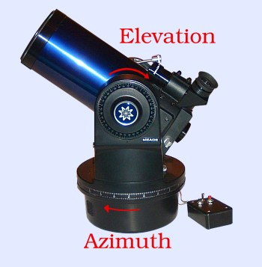
Image Rotation Angle
Angle of the Optical Tube Assembly (OTA) relative to the object viewed
Required for long exposure photography

Slide 7
Altitude-Azimuth Mount
Pros:
Direct encoder measurement of axes of interest
Cons:
Requires ‘image derotation’ for long exposure photography
Series mounted actuators require stronger motors

Slide 8
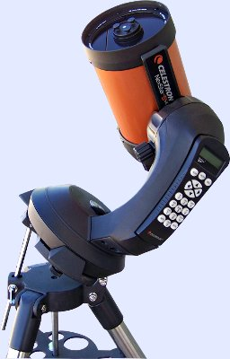
Equatorial Mount
Pros:
Does not require image derotation
Direct encoder measurement of axes
Cons:
Complicated load paths require heavier mount
Series mounted actuators require stronger motors
Notes:
Tilt to align with Earth’s rotational axis

Slide 9
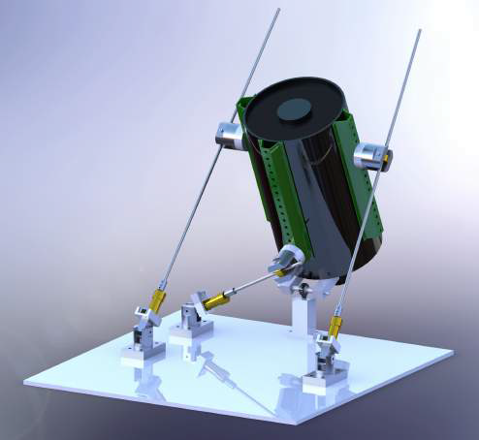
Parallel Actuator Mount
Pros:
Parallel Actuators share load
Two force members lead to simplified loading
Cons:
No direct measurement of desired angles
Notes:
Conceived by Dr. John Ridgely and initally implemented by Garrett Gudgel.

Slide 10
Mechanical Design

Slide 11
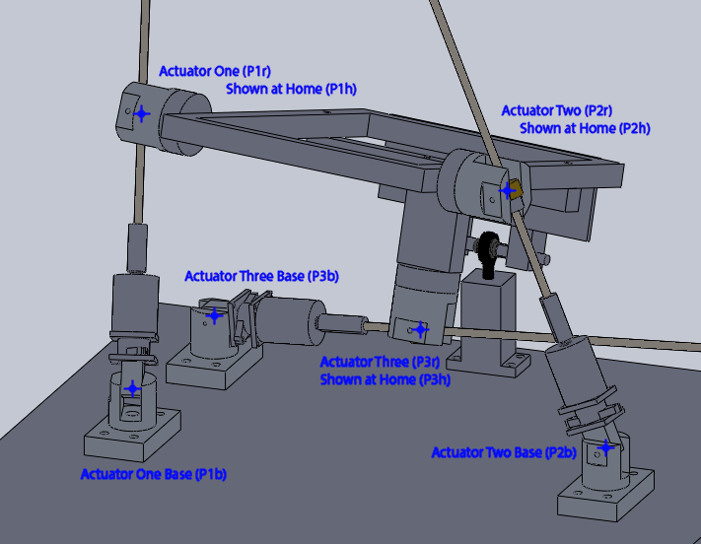
Notes:
System is composed of 3 @ linear actuators
6 @ Dual – Revolute Joints
1 @ Ball Joint

Slide 12
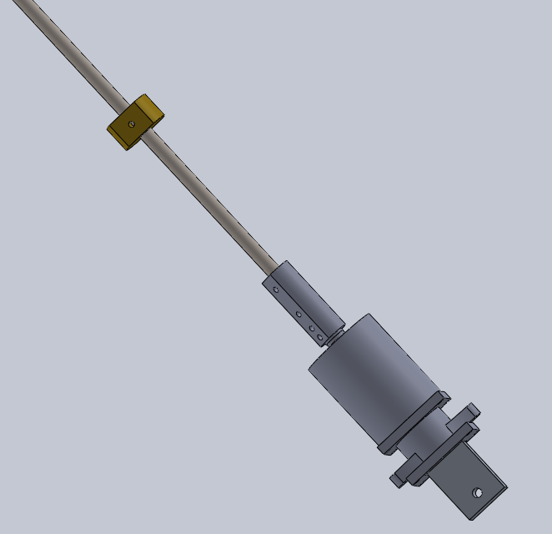
Linear Actuator
Stepper motor
Acme threaded rod
Acme nut
Solid coupler

Slide 13
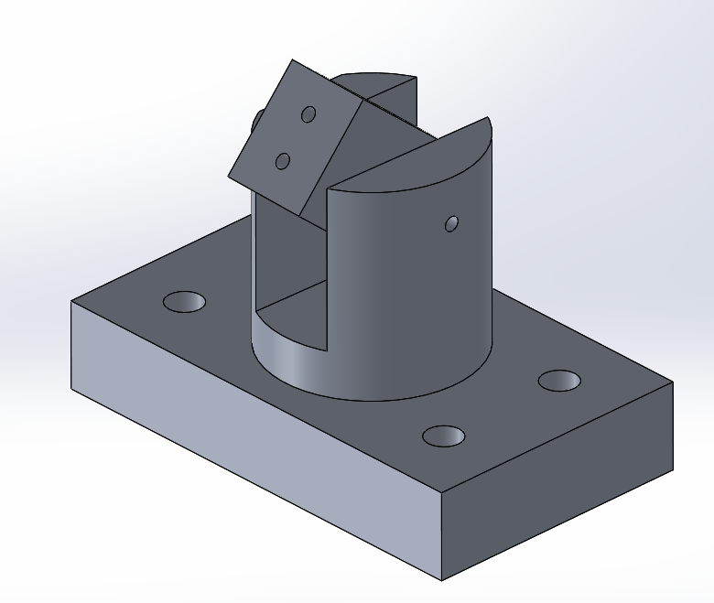
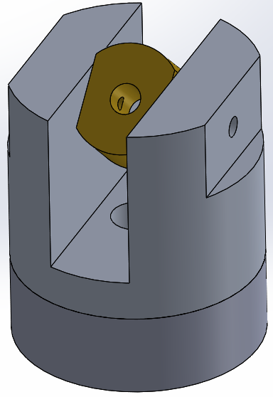
Dual-Revolute Joints
Support either end of linear actuator
Allow linear actuator to act as a two-force member

Slide 14
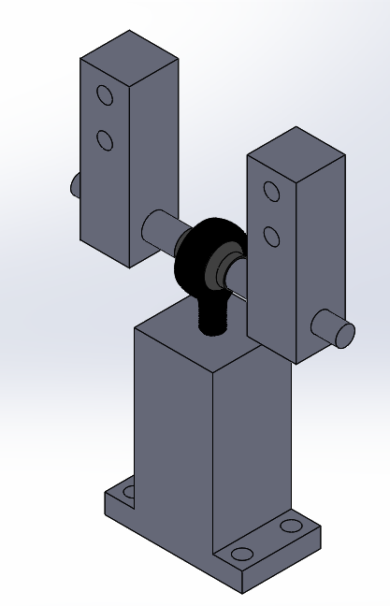
Ball Joint
Prevents translation but allows rotations
Simple rod end ball joint

Slide 15
Electrical Design

Slide 16
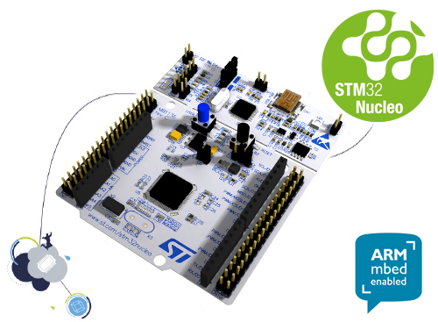
Microcontroller - STM32 Nucleo-L476RG
Onboard Floating Point Unit
80MHz
Micropython compatible
Low cost

Slide 17
Micropython
Implementation of Python 3 optimized for use on microcontrollers
Designed to be compatible with normal Python
Includes a subset of the Python standard library
Direct control of hardware
Published under MIT License
Notes:
Uses USB-OTG to drag and drop files onto the microcontroller
Full interactive Repl prompt
Fast and inexpensive way to get applications running and tested on microcontrollers

Slide 18
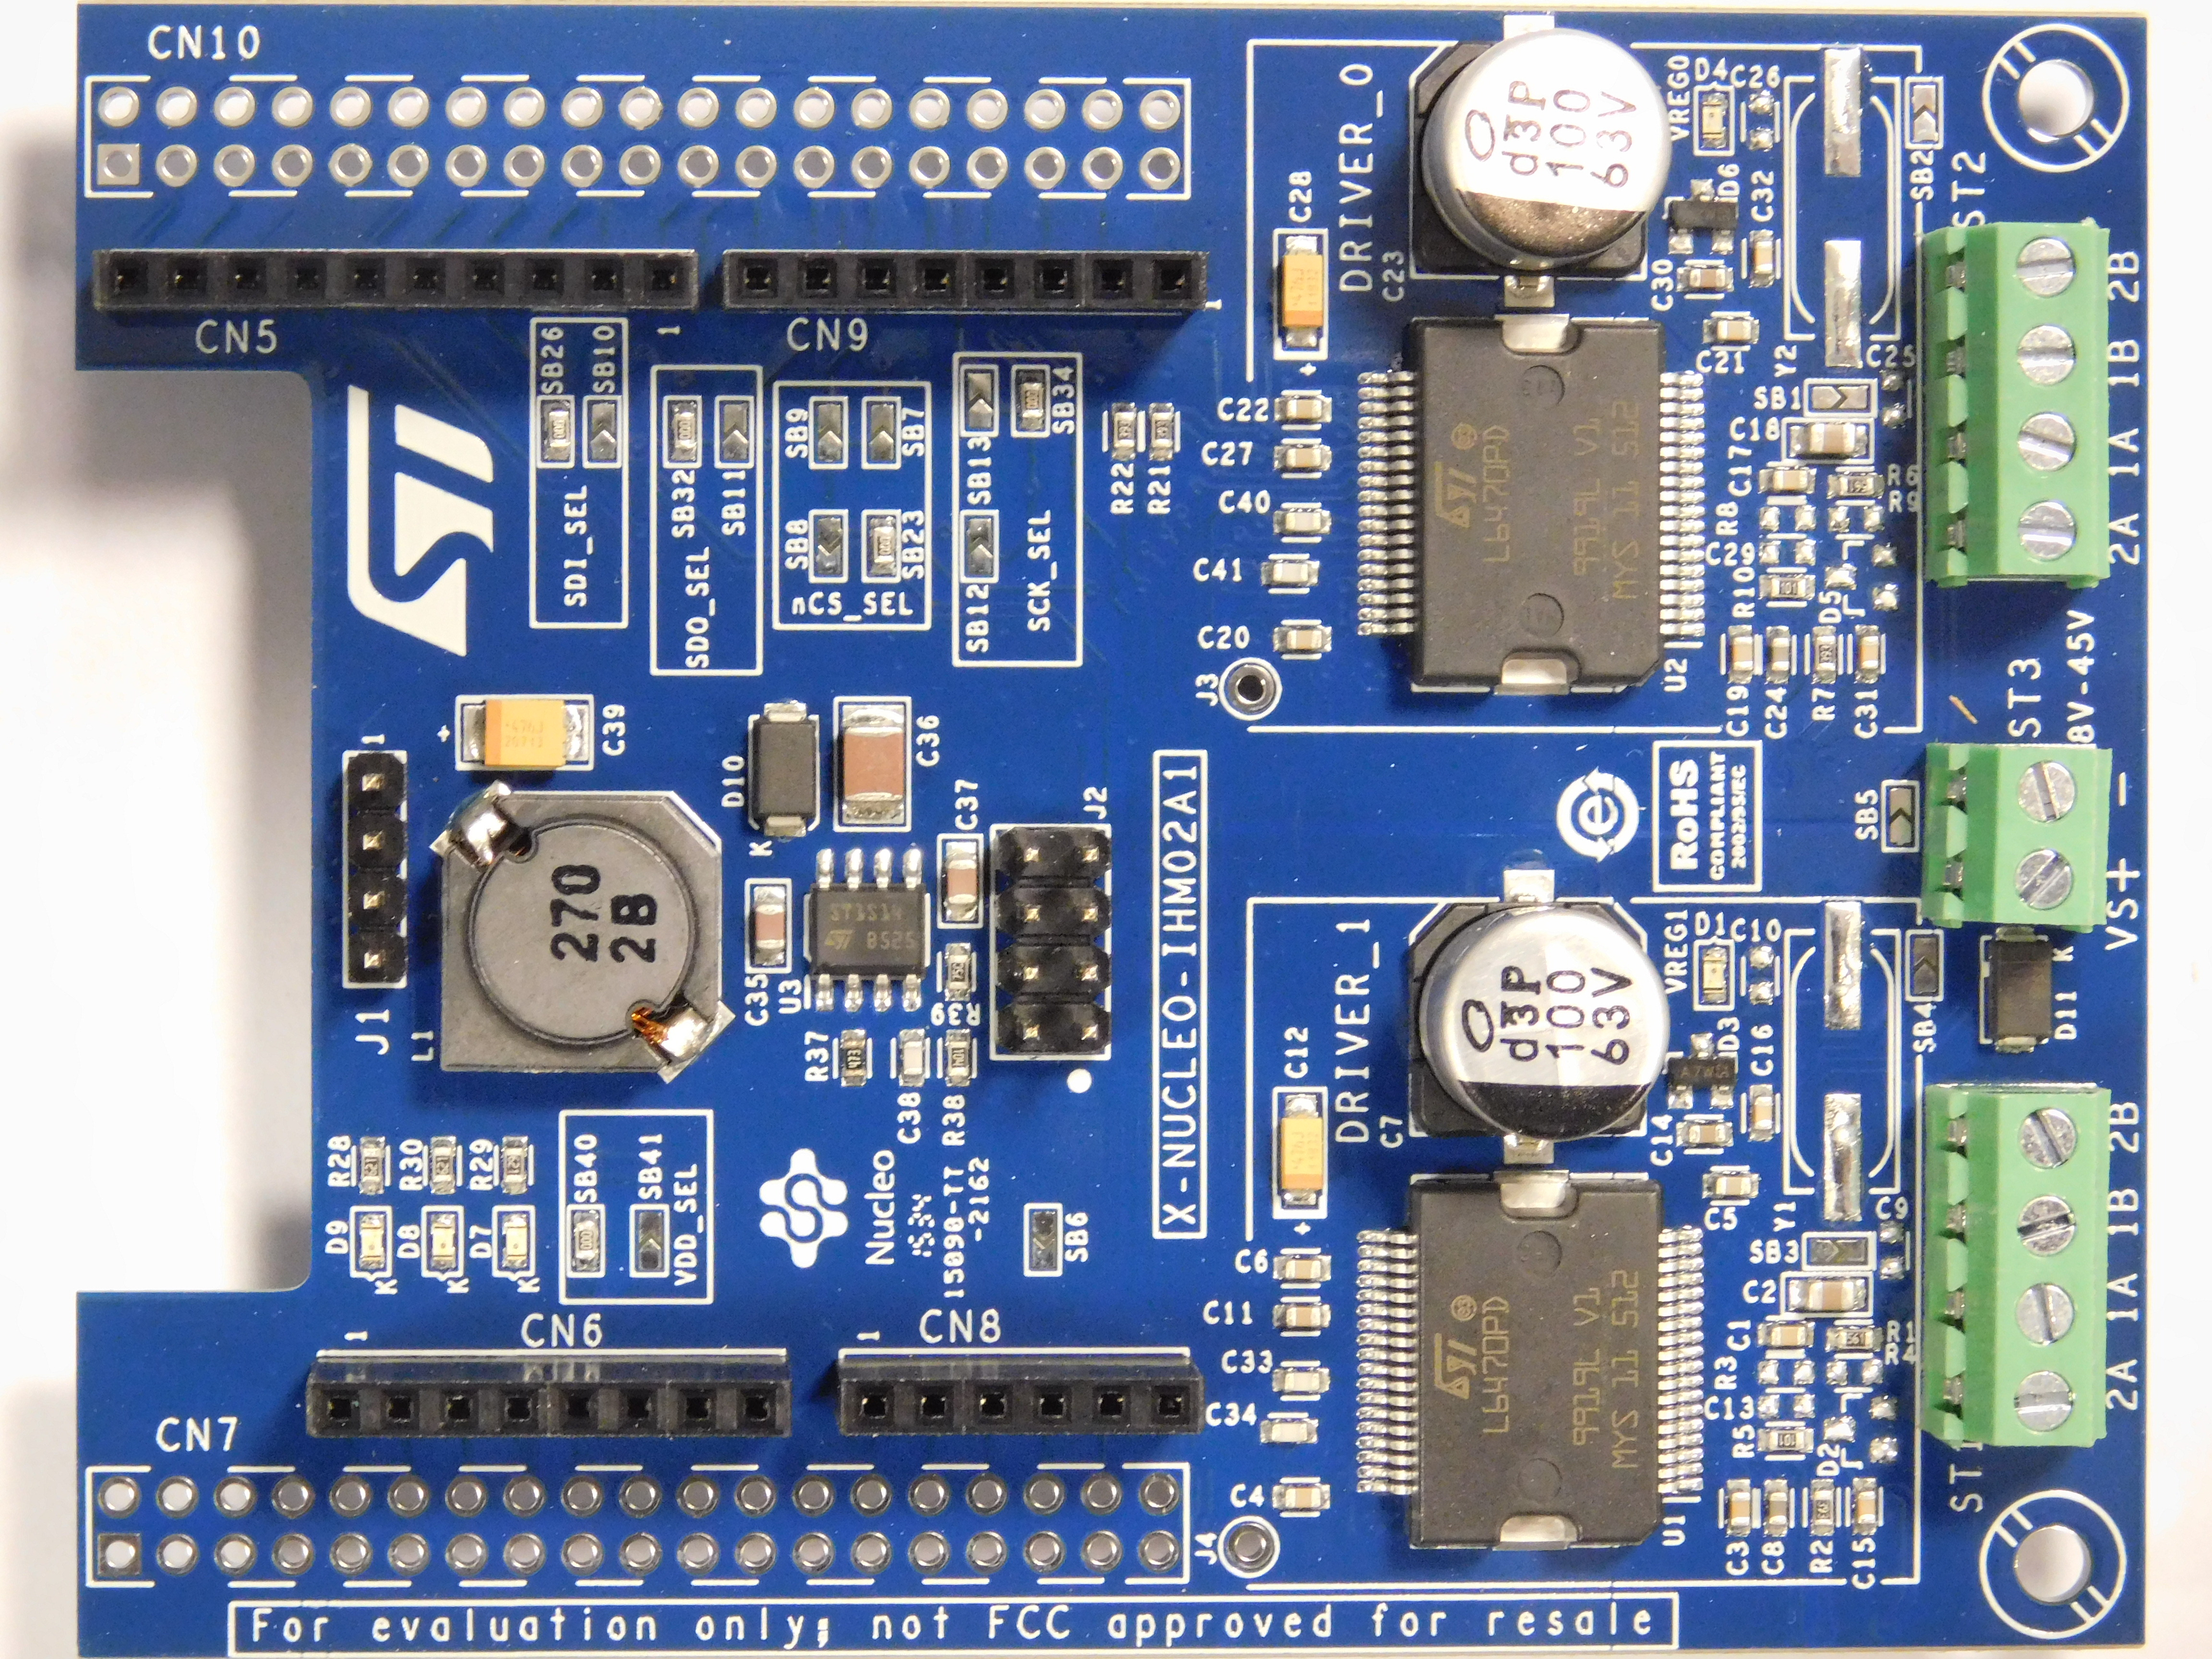
Stepper Motor Driver – L6470
Bipolar stepper motor driver with up to 1/128 microstepping
Daisy chainable SPI
Tunable motor parameters
Notes:
No micropython drivers available. Had to write them.

Slide 19
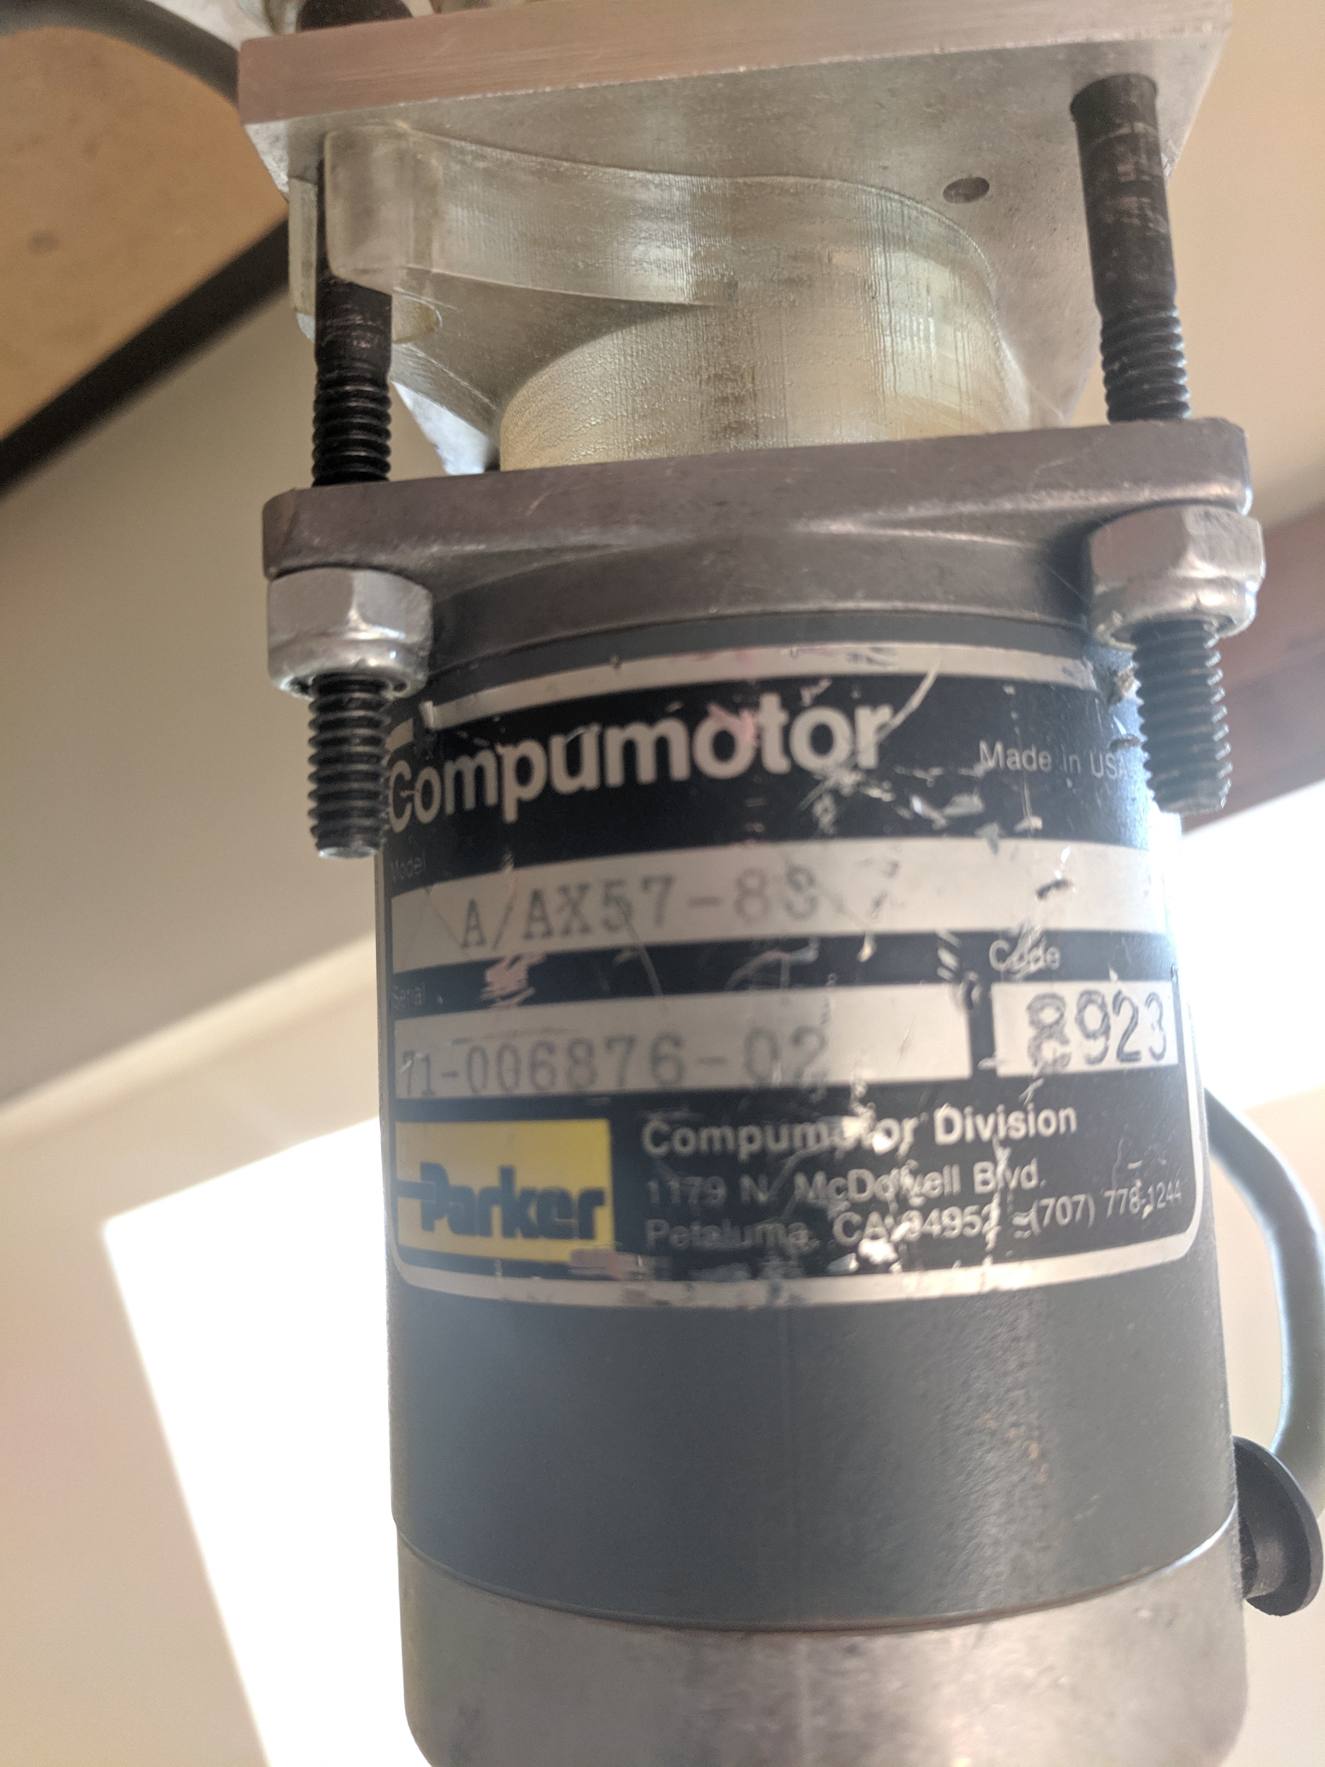
Stepper Motor
Salvaged stepper motors
200 steps/rev
9.4VDC
100 oz-in holding torque
Notes:
Probably needed higher torque
Accuracy seems fine but 400 steps/rev would be nice

Slide 20
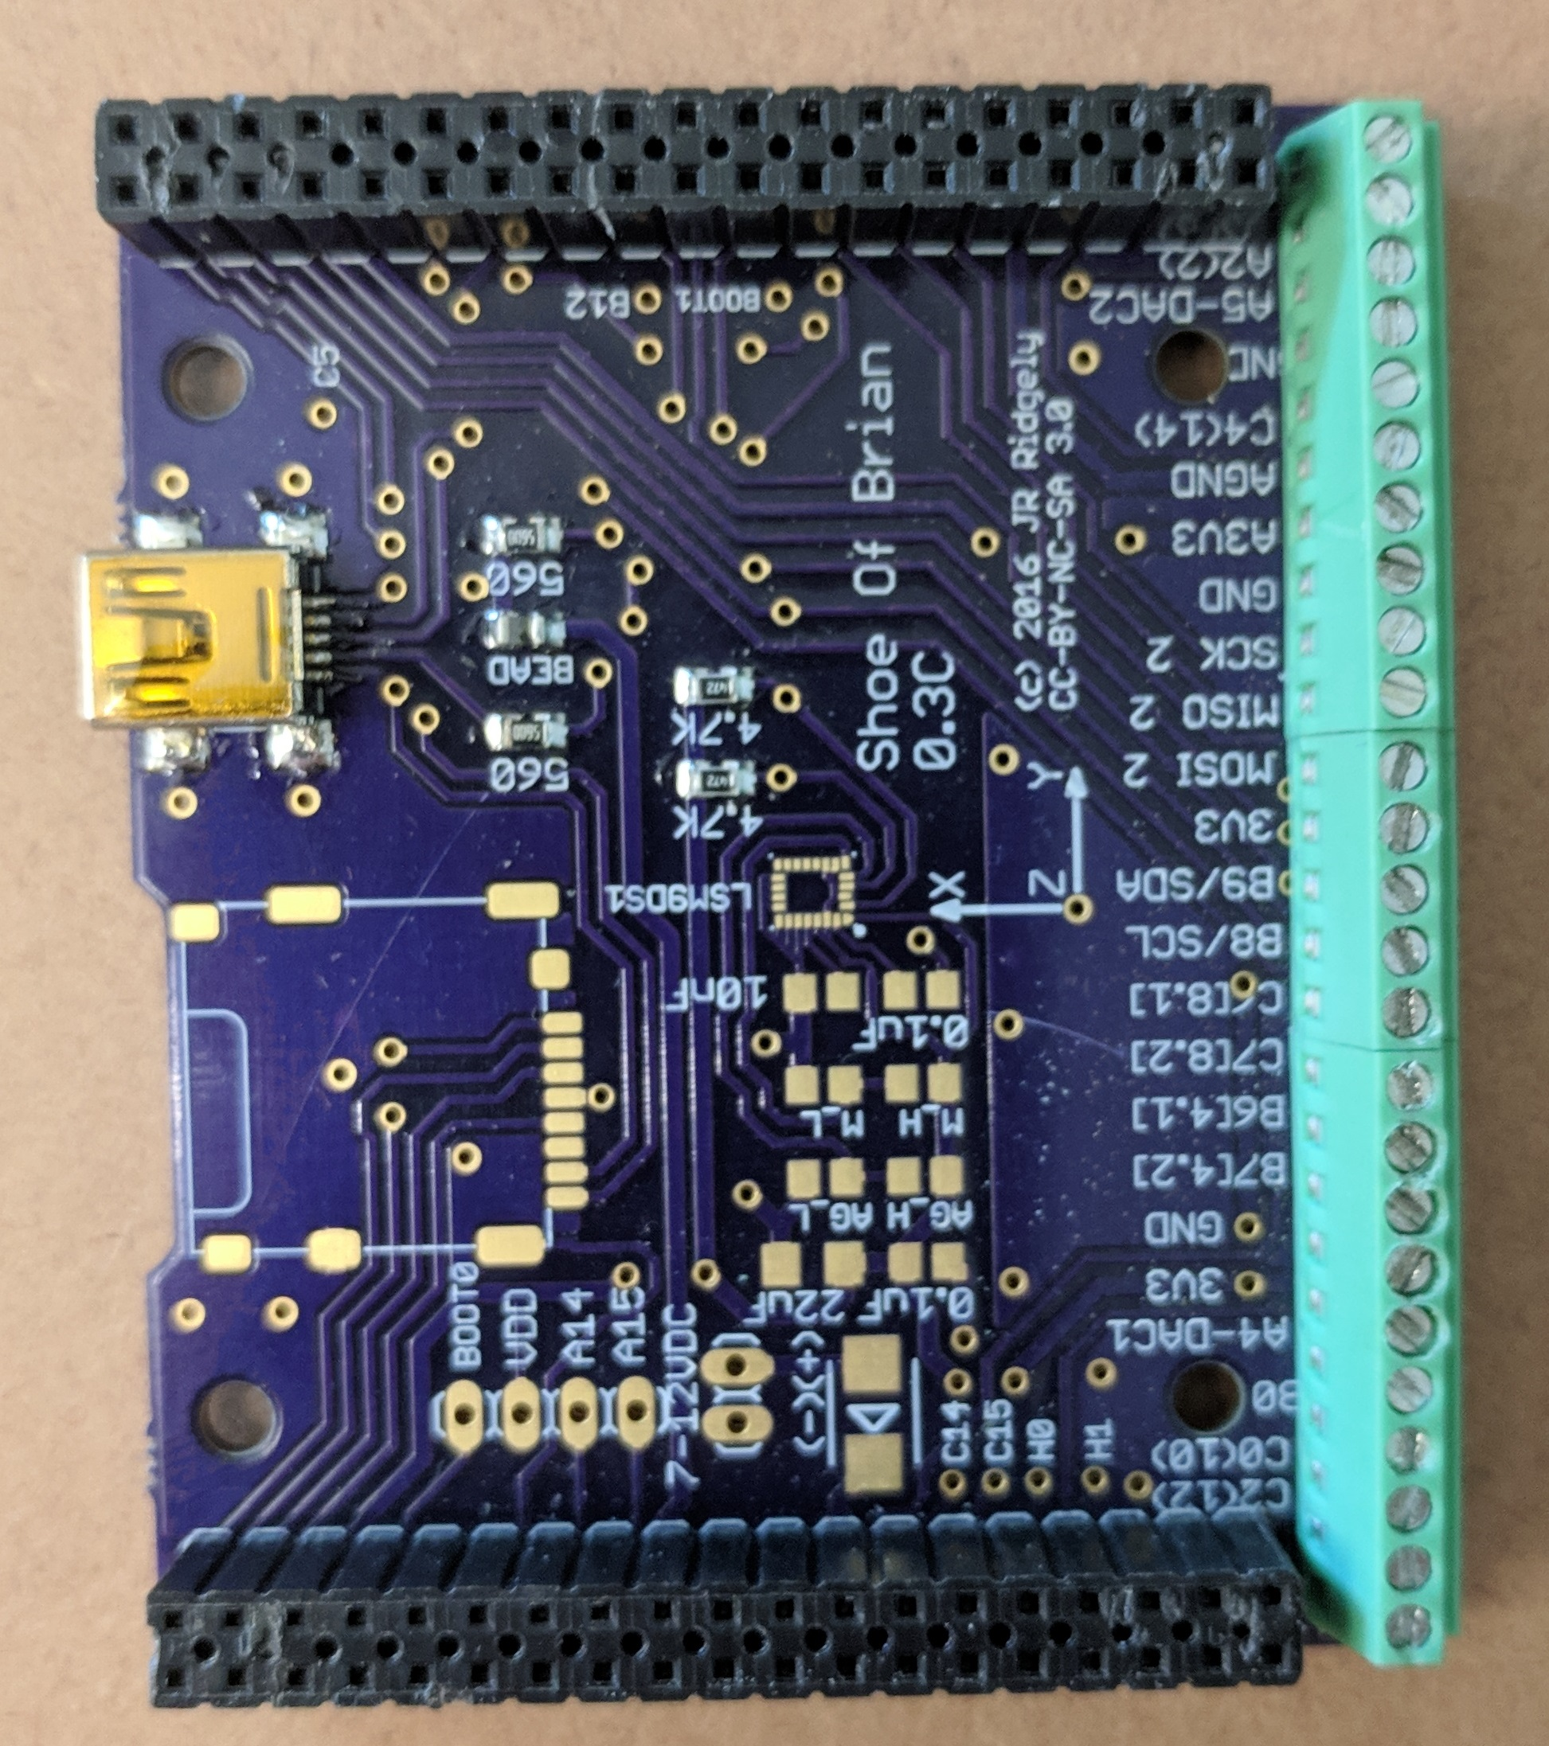
Shoe of Brian
Only non-commerical part of the electrical system
Required to install micropython on the Nucleo

Slide 21
Control

Slide 22
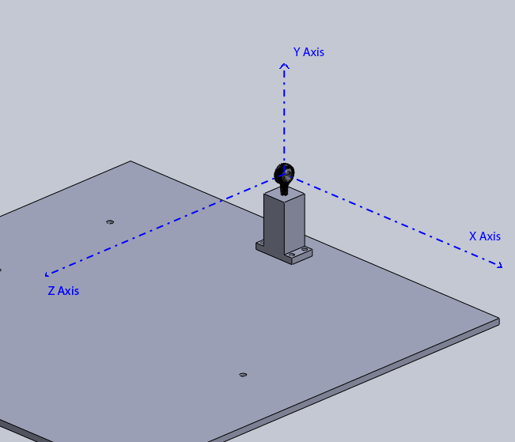
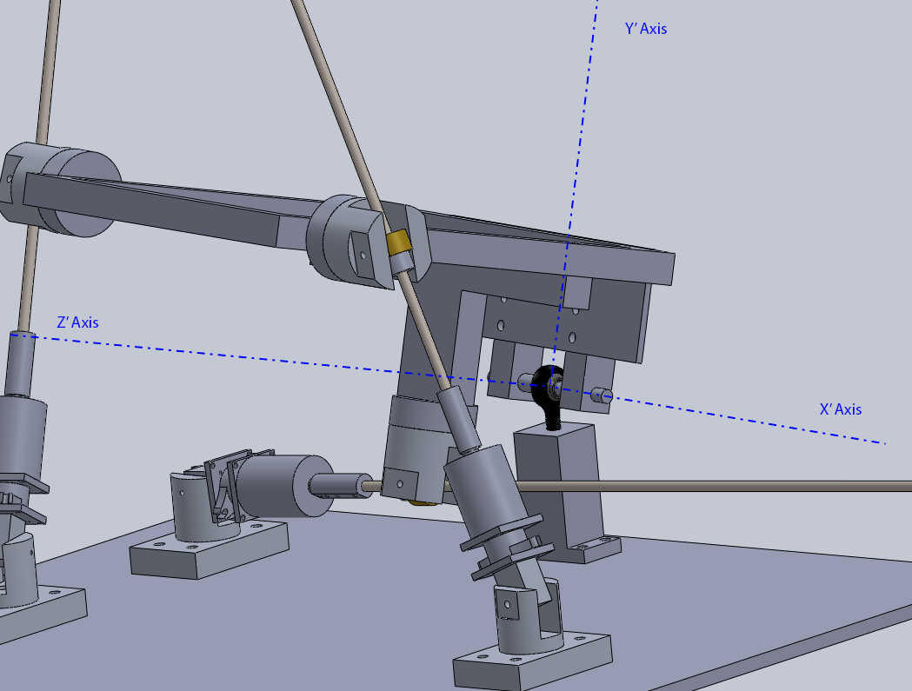
Transformation Coordinate Systems
Base Coordinate System – ‘b’
Telescope Coordinate System – ‘s’
Notes:
Rotation about Y, then X, then Z
Always referencing the home position makes calculating lengths based off of desired angular position very easy but calculating velocities harder
Required linear velocities are calculated by taking a time step, forward calculating the required angular positions after that time step had occurred, finding the lengths required for that new position, and calculating the linear velocities required to move from the current position to the new one. After running for one timestep seconds, the process is repeated.

Slide 23
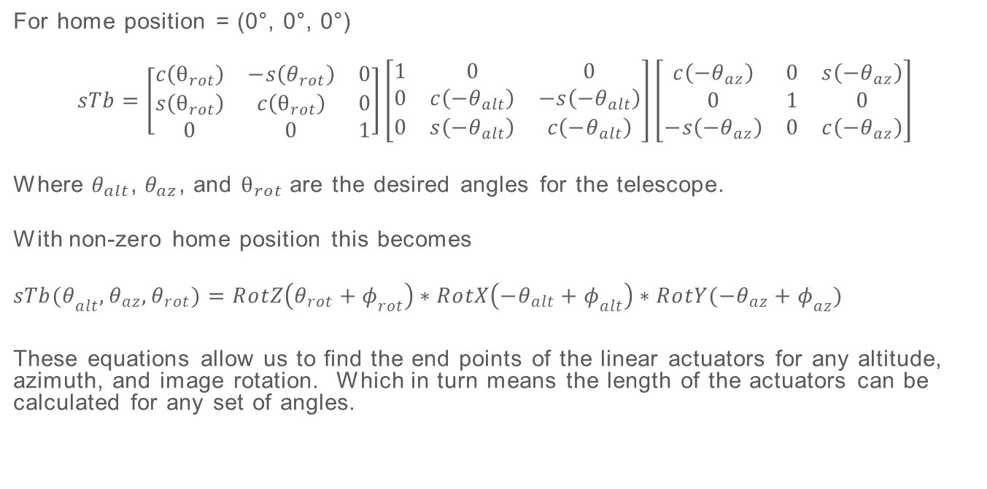
Transformation Matrices
For home position = (0°, 0°, 0°)
$$sTb=\left[\begin{matrix}c\left(θ_{rot}\right) & −s\left(θ_{rot}\right) & 0 \\ s\left(θ_{rot}\right) & c\left(θ_{rot}\right) & 0 \\ 0 & 0 & 1\end{matrix}\right]\left[\begin{matrix}1 & 0 & 0 \\ 0 & c\left(−θ_{alt}\right) & −s\left(−θ_{alt}\right) \\ 0 & s\left(−θ_{alt}\right) & c\left(−θ_{alt}\right)\end{matrix}\right]\left[\begin{matrix}c\left(−θ_{az}\right) & 0 & s\left(−θ_{az}\right) \\ 0 & 1 & 0 \\ −s\left(−θ_{az}\right) & 0 & c\left(−θ_{az}\right)\end{matrix}\right]$$
Where $θ_{alt}$, $θ_{az}$, and $θ_{rot}$ are the desired angles for the telescope.
With non-zero home position this becomes
$$sTb{(θ}_{alt}, θ_{az},θ_{rot})=RotZ\left(θ_{rot}+φ_{rot}\right)∗RotX\left(−θ_{alt}+φ_{alt}\right)∗RotY(−θ_{az}+φ_{az})$$
These equations allow us to find the end points of the linear actuators for any altitude, azimuth, and image rotation. Which in turn means the length of the actuators can be calculated for any set of angles.

Slide 24
Velocity

Slide 25
References
http://www.astronomyhints.com/mounts.html
https://commons.wikimedia.org/w/index.php?curid=17727911
“Three Degree-of-Freedom Parallel Actuator Telescope Mount” - http://digitalcommons.calpoly.edu/theses/1547

Slide 26
Questions?

Slide 27
Traditional Telescope Mounts

